Slide 2
What is ETL?
The purpose of Informatica ETL is to provide the users, not only a process of extracting data from source systems and bringing it into the data warehouse, but also provide the users with a common platform to integrate their data from various platforms and applications

Slide 3
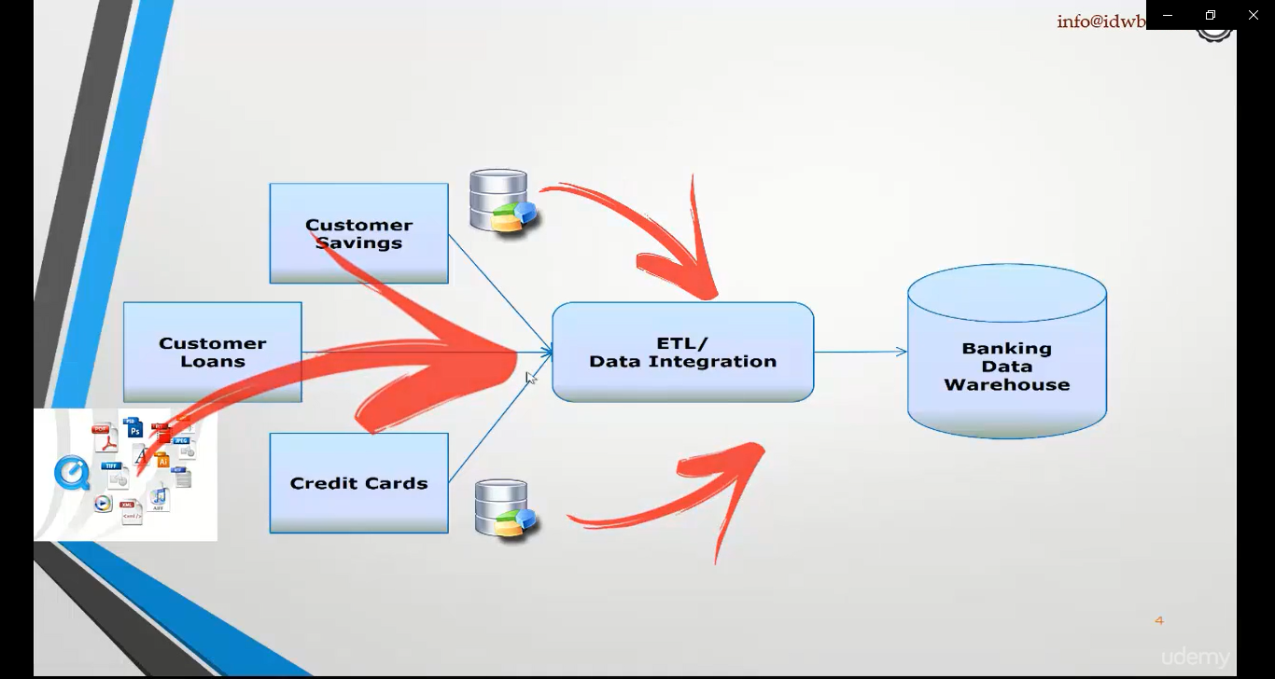

Slide 4
ETL Introduction……
ETL is defined as a process that extracts the data from different RDBMS source systems, then transforms the data (like applying calculations, concatenations, etc.) and finally loads the data into the Data Warehouse system. ETL full-form is Extract, Transform and Load.
It's tempting to think a creating a Data warehouse is simply extracting data from multiple sources and loading into database of a Data warehouse. This is far from the truth and requires a complex ETL process. The ETL process requires active inputs from various stakeholders including developers, analysts, testers, top executives and is technically challenging.
In order to maintain its value as a tool for decision-makers, Data warehouse system needs to change with business changes. ETL is a recurring activity (daily, weekly, monthly) of a Data warehouse system and needs to be agile, automated, and well documented.

Slide 5
Why do you need ETL?
There are many reasons for adopting ETL in the organization:
It helps companies to analyze their business data for taking critical business decisions.
Transactional databases cannot answer complex business questions that can be answered by ETL.
A Data Warehouse provides a common data repository
ETL provides a method of moving the data from various sources into a data warehouse.
As data sources change, the Data Warehouse will automatically update.
Well-designed and documented ETL system is almost essential to the success of a Data Warehouse project.
Allow verification of data transformation, aggregation and calculations rules.
ETL process allows sample data comparison between the source and the target system.
ETL process can perform complex transformations and requires the extra area to store the data.
ETL helps to Migrate data into a Data Warehouse. Convert to the various formats and types to adhere to one consistent system.
ETL is a predefined process for accessing and manipulating source data into the target database.
ETL offers deep historical context for the business.
It helps to improve productivity because it codifies and reuses without a need for technical skills.

Slide 6
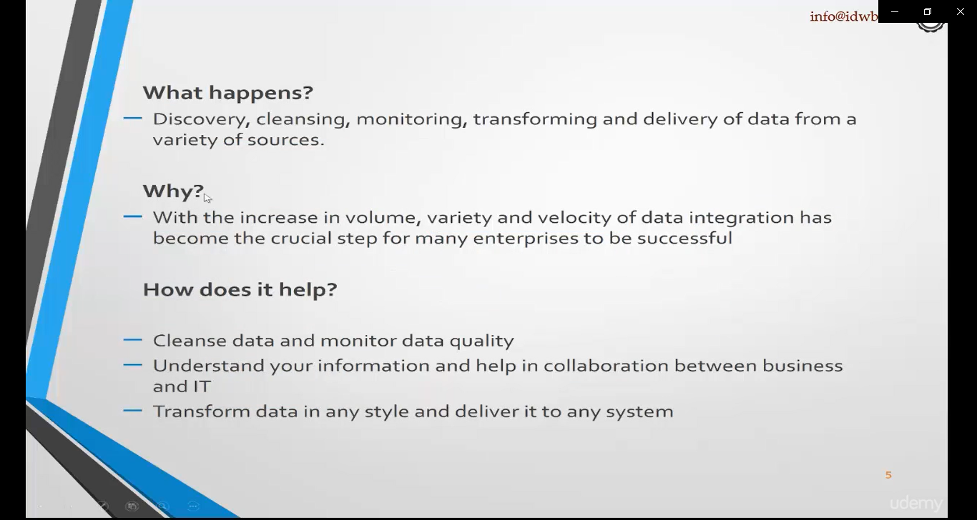

Slide 7
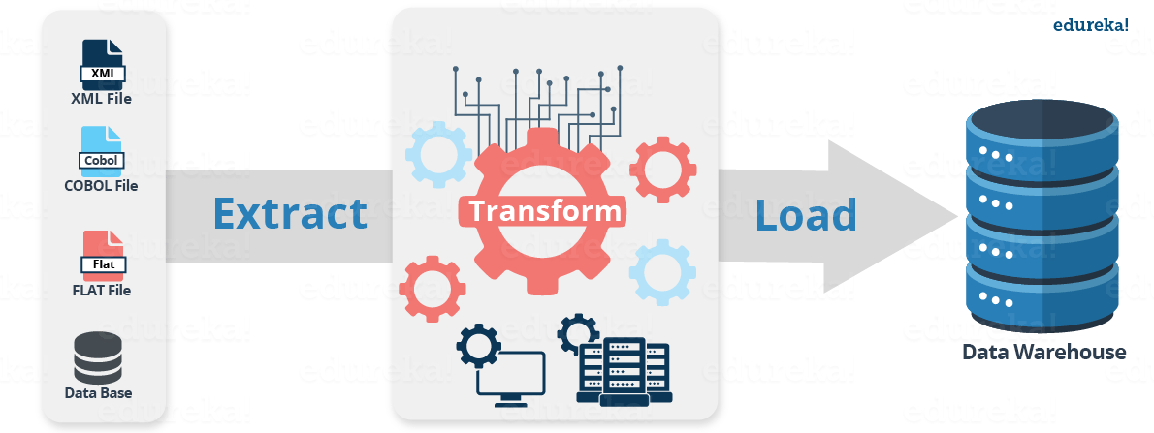
ETL Process in Data Warehouses

Slide 8
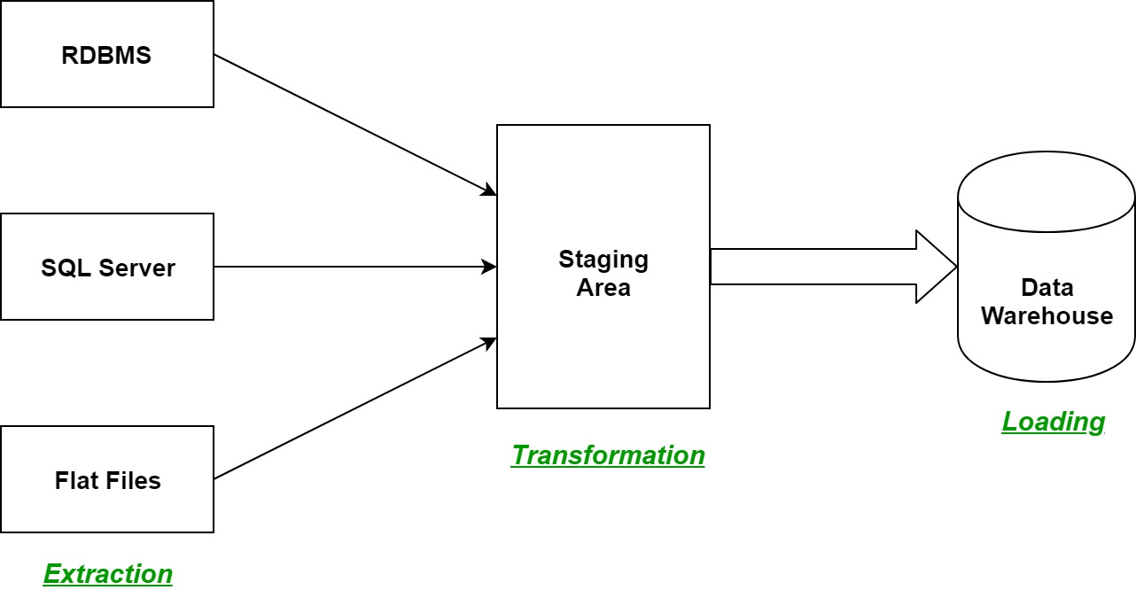

Slide 9
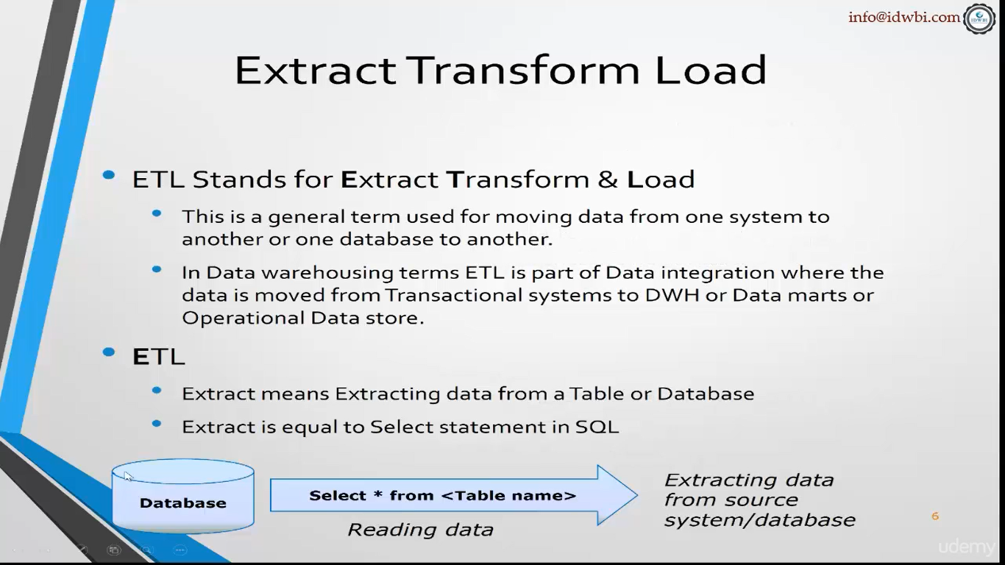

Slide 10
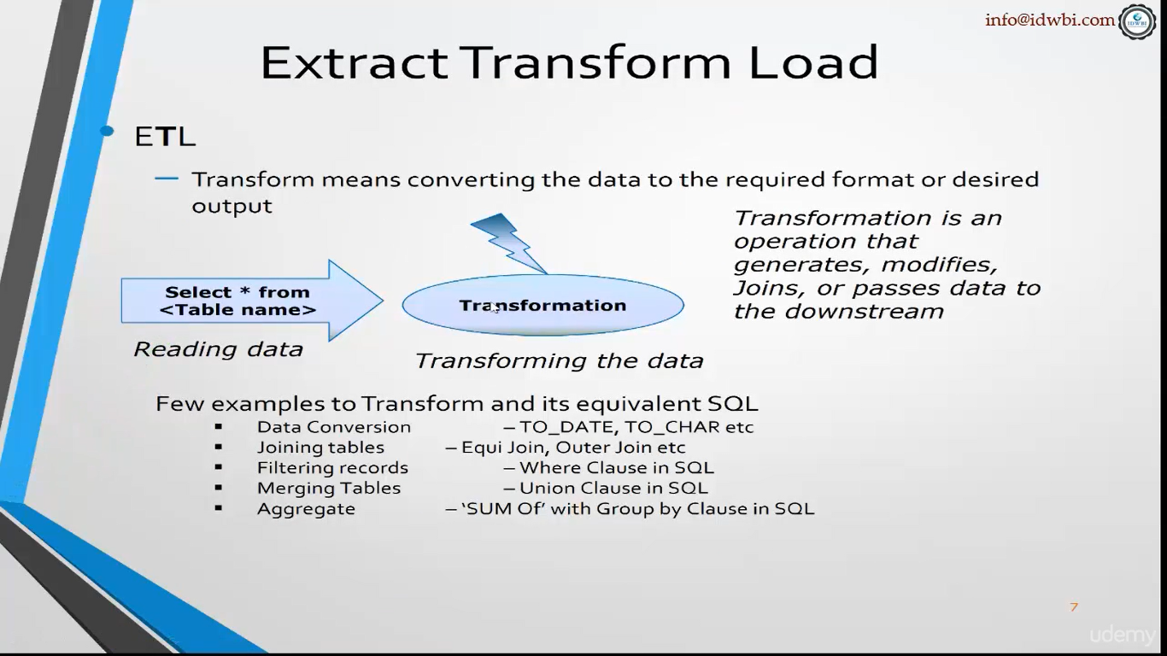

Slide 11
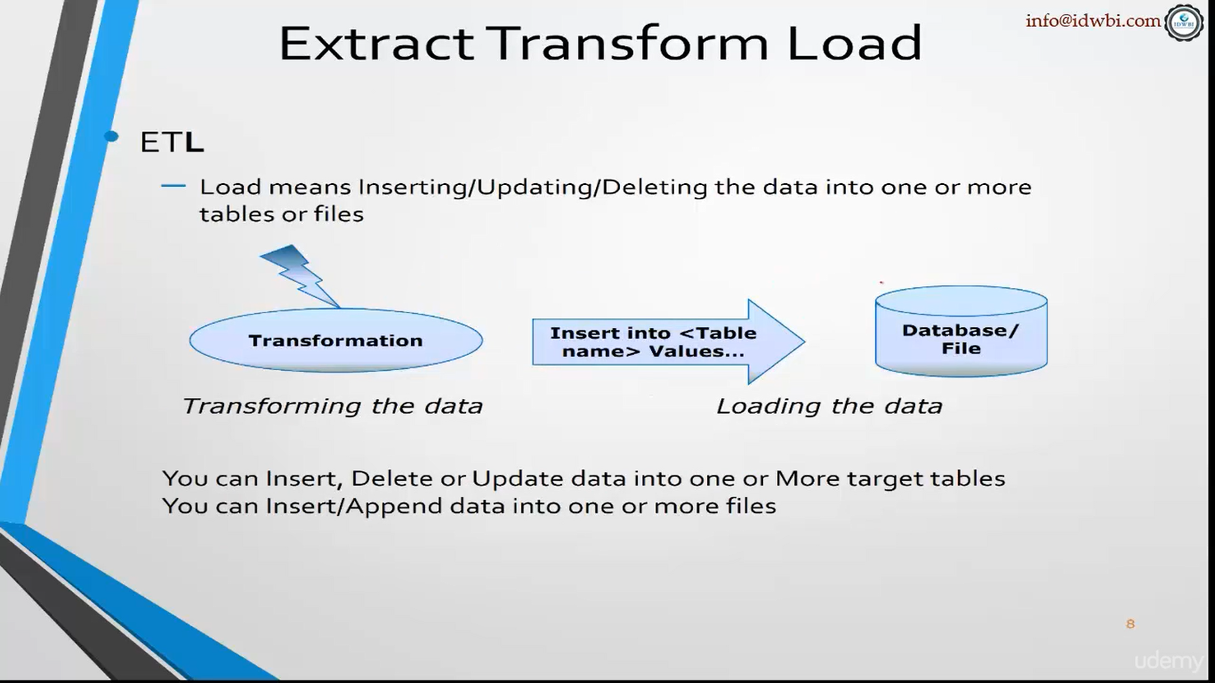

Slide 12
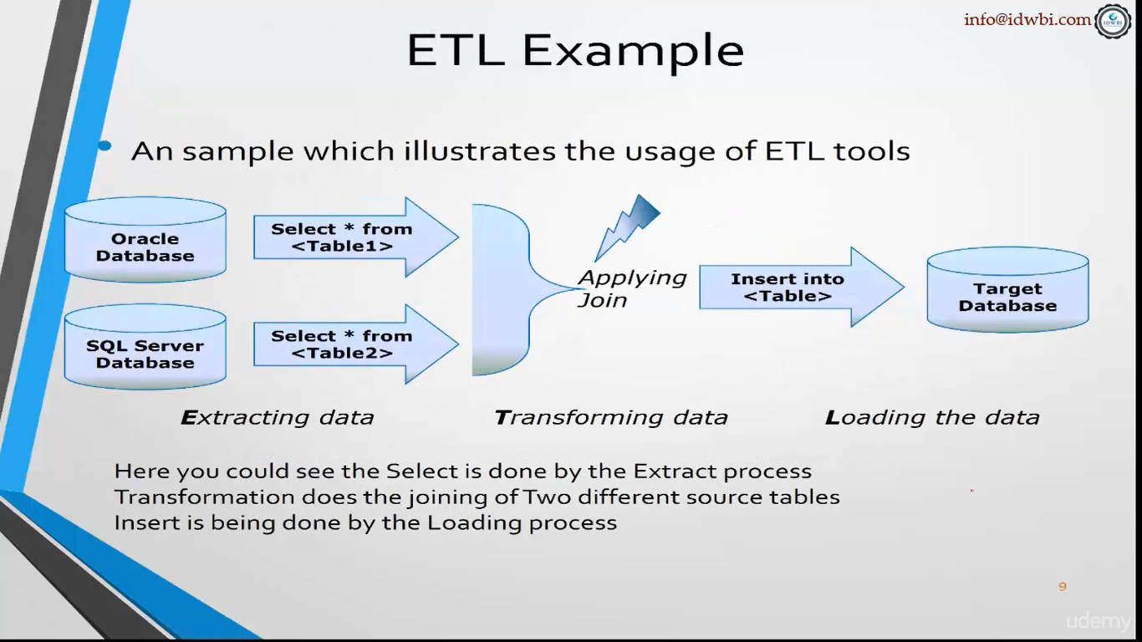

Slide 13
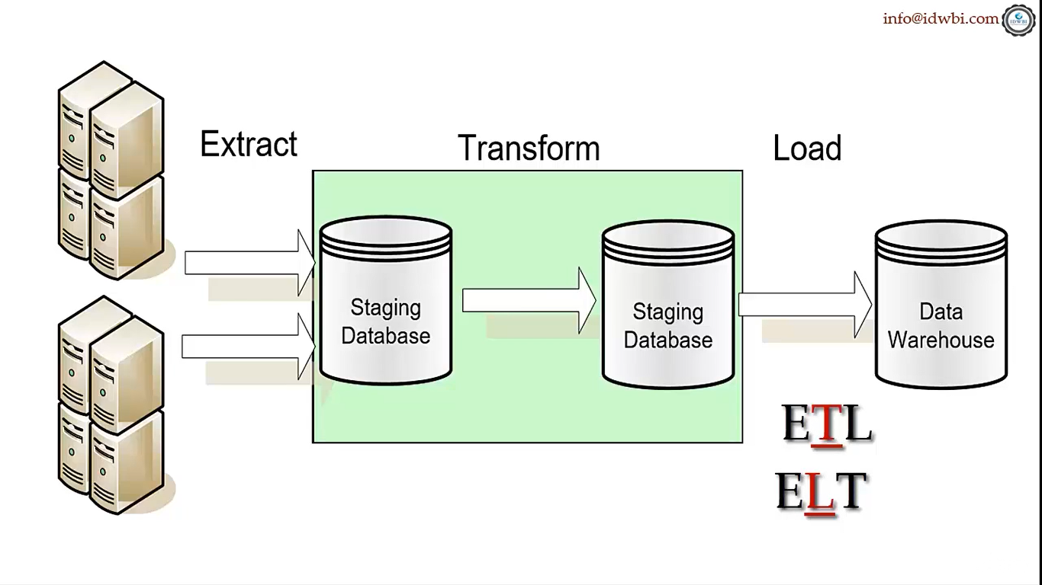

Slide 14
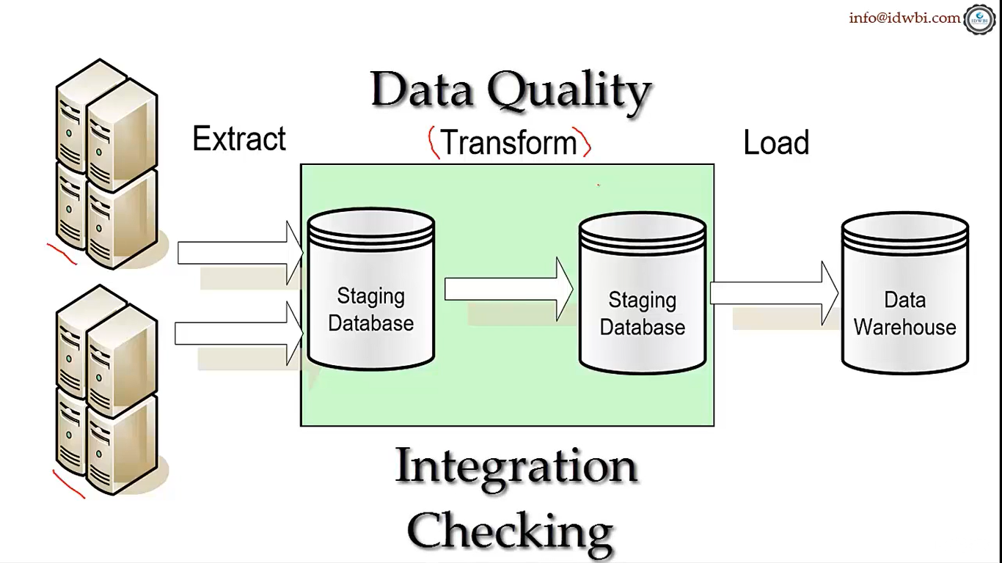

Slide 15
Step 1) Extraction
In this step, data is extracted from the source system into the staging area. Transformations if any are done in staging area so that performance of source system in not degraded. Also, if corrupted data is copied directly from the source into Data warehouse database, rollback will be a challenge. Staging area gives an opportunity to validate extracted data before it moves into the Data warehouse.
Data warehouse needs to integrate systems that have different
DBMS, Hardware, Operating Systems and Communication Protocols. Sources could include legacy applications like Mainframes, customized applications, Point of contact devices like ATM, Call switches, text files, spreadsheets, ERP, data from vendors, partners amongst others.
Hence one needs a logical data map before data is extracted and loaded physically. This data map describes the relationship between sources and target data.

Slide 16
Three Data Extraction methods:
Full Extraction
Partial Extraction- without update notification.
Partial Extraction- with update notification
Irrespective of the method used, extraction should not affect performance and response time of the source systems. These source systems are live production databases. Any slow down or locking could effect company's bottom line.

Slide 17
Some validations are done during Extraction:
Reconcile records with the source data
Make sure that no spam/unwanted data loaded
Data type check
Remove all types of duplicate/fragmented data
Check whether all the keys are in place or not

Slide 18
Example of data extraction
The first step of the ETL process is extraction.
In this step, data from various source systems is extracted which can be in various formats like relational databases, No SQL, XML and flat files into the staging area.
It is important to extract the data from various source systems and store it into the staging area first and not directly into the data warehouse because the extracted data is in various formats and can be corrupted also.
Hence loading it directly into the data warehouse may damage it and rollback will be much more difficult.
Therefore, this is one of the most important steps of ETL process.

Slide 19
Step 2) Transformation
Data extracted from source server is raw and not usable in its original form. Therefore it needs to be cleansed, mapped and transformed. In fact, this is the key step where ETL process adds value and changes data such that insightful BI reports can be generated.
In this step, you apply a set of functions on extracted data. Data that does not require any transformation is called as direct move or pass through data.
In transformation step, you can perform customized operations on data. For instance, if the user wants sum-of-sales revenue which is not in the database. Or if the first name and the last name in a table is in different columns. It is possible to concatenate them before loading.

Slide 20
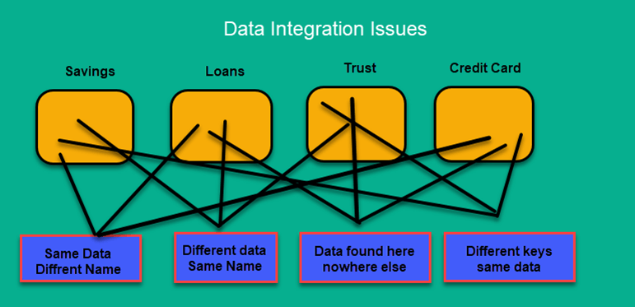

Slide 21
Following are Data Integrity Problems:
Different spelling of the same person like Jon, John, etc.
There are multiple ways to denote company name like Google, Google Inc.
Use of different names like Cleaveland, Cleveland.
There may be a case that different account numbers are generated by various applications for the same customer.
In some data required files remains blank
Invalid product collected at POS as manual entry can lead to mistakes.

Slide 22
Validations are done during this stage
Filtering – Select only certain columns to load
Using rules and lookup tables for Data standardization
Character Set Conversion and encoding handling
Conversion of Units of Measurements like Date Time Conversion, currency conversions, numerical conversions, etc.
Data threshold validation check. For example, age cannot be more than two digits.
Data flow validation from the staging area to the intermediate tables.
Required fields should not be left blank.
Cleaning ( for example, mapping NULL to 0 or Gender Male to "M" and Female to "F" etc.)
Split a column into multiples and merging multiple columns into a single column.
Transposing rows and columns,
Use lookups to merge data
Using any complex data validation (e.g., if the first two columns in a row are empty then it automatically reject the row from processing)

Slide 23
Example of Data transformations
In data transformation, you apply a set of functions on extracted data to load it into the target system. Data, which does not require any transformation is known as direct move or pass through data.
You can apply different transformations on extracted data from the source system. For example, you can perform customized calculations. If you want sum-of-sales revenue and this is not in database, you can apply the SUM formula during transformation and load the data.
For example, if you have the first name and the last name in a table in different columns, you can use concatenate before loading.

Slide 24
Transformation Example….
The second step of the ETL process is transformation. In this step, a set of rules or functions are applied on the extracted data to convert it into a single standard format. It may involve following processes/tasks:
Filtering – loading only certain attributes into the data warehouse.
Cleaning – filling up the NULL values with some default values, mapping U.S.A, United States and America into USA, etc.
Joining – joining multiple attributes into one.
Splitting – splitting a single attribute into multipe attributes.
Sorting – sorting tuples on the basis of some attribute (generally key-attribbute).

Slide 25
Step 3) Loading
Loading data into the target data warehouse database is the last step of the ETL process. In a typical Data warehouse, huge volume of data needs to be loaded in a relatively short period (nights). Hence, load process should be optimized for performance.
In case of load failure, recover mechanisms should be configured to restart from the point of failure without data integrity loss. Data Warehouse admins need to monitor, resume, cancel loads as per prevailing server performance.
Types of Loading:
Initial Load — populating all the Data Warehouse tables
Incremental Load — applying ongoing changes as when needed periodically.
Full Refresh —erasing the contents of one or more tables and reloading with fresh data.

Slide 26
Load verification
Ensure that the key field data is neither missing nor null.
Test modeling views based on the target tables.
Check that combined values and calculated measures.
Data checks in dimension table as well as history table.
Check the BI reports on the loaded fact and dimension table.

Slide 27
Load
The third and final step of the ETL process is loading.
In this step, the transformed data is finally loaded into the data warehouse.
Sometimes the data is updated by loading into the data warehouse very frequently and sometimes it is done after longer but regular intervals.
The rate and period of loading solely depends on the requirements and varies from system to system.

Slide 28
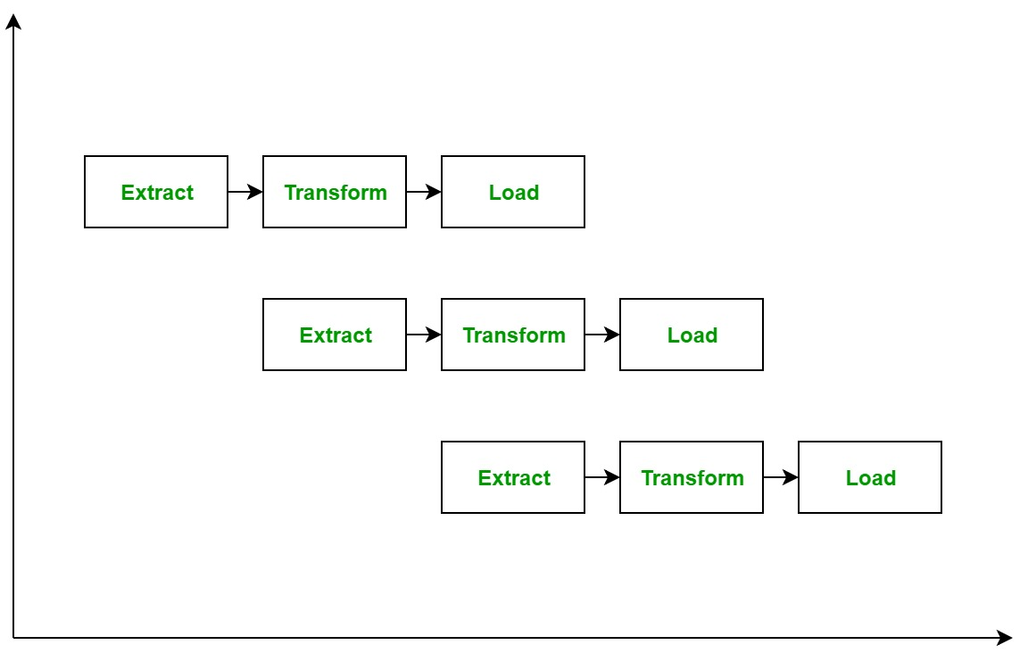
ETL Pipelining Process:
ETL process can also use the pipelining concept i.e. as soon as some data is extracted, it can transformed and during that period some new data can be extracted. And while the transformed data is being loaded into the data warehouse, the already extracted data can be transformed. The block diagram of the pipelining of ETL process is shown below:

Slide 29
ETL tools
There are many Data Warehousing tools are available in the market. Here, are some most prominent one:
1. MarkLogic:
MarkLogic is a data warehousing solution which makes data integration easier and faster using an array of enterprise features. It can query different types of data like documents, relationships, and metadata.
2. Oracle:
Oracle is the industry-leading database. It offers a wide range of choice of Data Warehouse solutions for both on-premises and in the cloud. It helps to optimize customer experiences by increasing operational efficiency.
3. Amazon RedShift:
Amazon Redshift is Datawarehouse tool. It is a simple and cost-effective tool to analyze all types of data using standard SQL and existing BI tools. It also allows running complex queries against petabytes of structured data.
4. Sybase:
5. CloverETL

Slide 30
Xplenty.com
DreamFactory (a streamlined alternative to ETL)
Informatica - Power Center
IBM - Websphere DataStage(Formerly known as Ascential DataStage)
SAP - BusinessObjects Data Integrator
IBM - Cognos Data Manager (Formerly known as Cognos DecisionStream)
Microsoft - SQL Server Integration Services
Oracle - Data Integrator (Formerly known as Sunopsis Data Conductor)
SAS - Data Integration Studio
Oracle - Warehouse Builder
AB Initio
Information Builders - Data Migrator
Pentaho - Pentaho Data Integration
Embarcadero Technologies - DT/Studio
IKAN - ETL4ALL
IBM - DB2 Warehouse Edition
Pervasive - Data Integrator
ETL Solutions Ltd. - Transformation Manager
Group 1 Software (Sagent) - DataFlow
Sybase - Data Integrated Suite ETL
Talend - Talend Open Studio
Expressor Software - Expressor Semantic Data Integration System
Elixir - Elixir Repertoire
OpenSys - CloverETL
IronMQ - cloud-based queuing/worker to enable ETL

Slide 31
ETL Lookup Stage:
ETL lookup stage enables us to evaluate data with various options, but it cannot be used in the case of a giant database as data can be analyzed only when it is in memory. Although, it is the more preferable one as compared to join and merge stages. Additionally, the lookup stage also permits the condition-based data analysis.
Properties of the Lookup Stage:
It is a processing stage.
It works on memory by reading data from a dataset.
Direct lookup on DB2 and Oracle can also be performed.
Lookup is also used for the validation of rows. It rejects a row if it doesn’t not have a corresponding entry.
Lookup stage can have single or multiple reference links, but a single input link and a single output link.

Slide 32
This stage can be worked with three options:
Equality Match: This is also known as the normal look. Here, data is looked at for the exact case-sensitive match.
Casesless Match: This function looks for values with no importance to case sensitivity.
Range Match: With the help of the range function, a lookup stage can be configured to look up for a range of values between two lookup columns.
Lookup stage is ideal for small amounts of data as compared to join and merge stages, as it uses memory to process data. However, it is not possible to use the lookup stage for a huge amount of data. For databases or datasets with huge values, a join stage or a merge stage is used. The drawbacks of the join stage include the fact that it cannot reject a row that is not having a corresponding entry; whereas, the merge stage can help us reject such values.

Slide 33
Best practices ETL process
Never try to cleanse all the data:
Every organization would like to have all the data clean, but most of them are not ready to pay to wait or not ready to wait. To clean it all would simply take too long, so it is better not to try to cleanse all the data.
Never cleanse Anything:
Always plan to clean something because the biggest reason for building the Data Warehouse is to offer cleaner and more reliable data.
Determine the cost of cleansing the data:
Before cleansing all the dirty data, it is important for you to determine the cleansing cost for every dirty data element.
To speed up query processing, have auxiliary views and indexes:
To reduce storage costs, store summarized data into disk tapes. Also, the trade-off between the volume of data to be stored and its detailed usage is required. Trade-off at the level of granularity of data to decrease the storage costs.

Slide 34
Summary:
ETL is an abbreviation of Extract, Transform and Load.
ETL provides a method of moving the data from various sources into a data warehouse.
In the first step extraction, data is extracted from the source system into the staging area.
In the transformation step, the data extracted from source is cleansed and transformed .
Loading data into the target datawarehouse is the last step of the ETL process.

